Slide 1


Generation SG JDE05 Interim Project
By
Daniel, Pin Pin, Pin Yeen, Shawn
DPPS

Slide 2

Initial objective
Local favourite: Air tickets before and after COVID
Pursued several sources like Amadeus, Trip.com, Booking.com, Singapore Airlines, Agoda, Expedia etc.
None provided historical prices, only booking of flight and lodging

Slide 3

Further brainstorming
Another local favourite: Resale HDB
Decided on DATA.Gov.SG API/Data
Comprehensive data and 100% Singapore context

Slide 4

Problem Statement
In order to save on electricity bills, search for a resale flat at the coolest town in Singapore within a specified budget

Slide 5

Data needed for analysis
Air temperature
Humidity
Resale HDB transaction prices

Slide 6

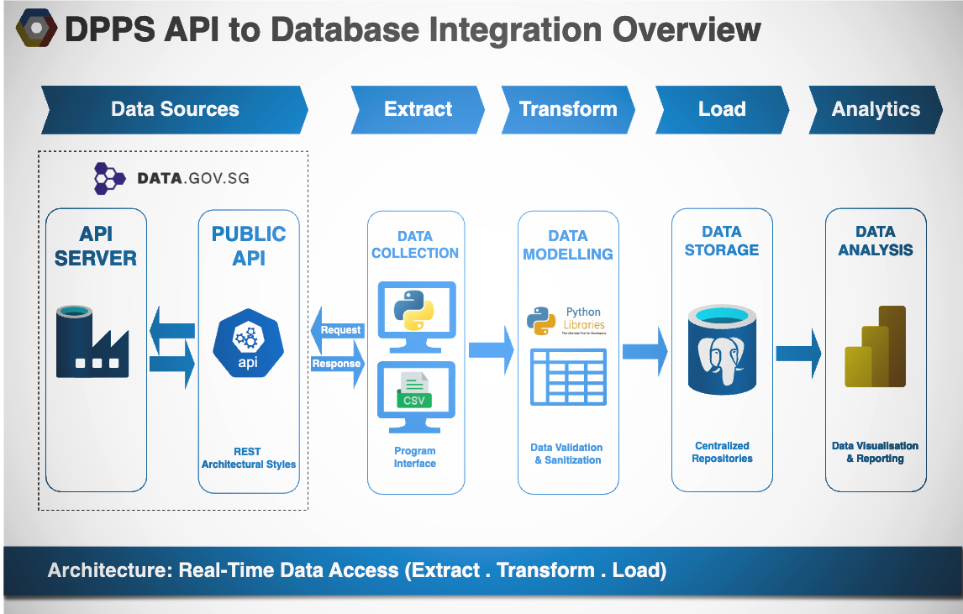

Slide 7
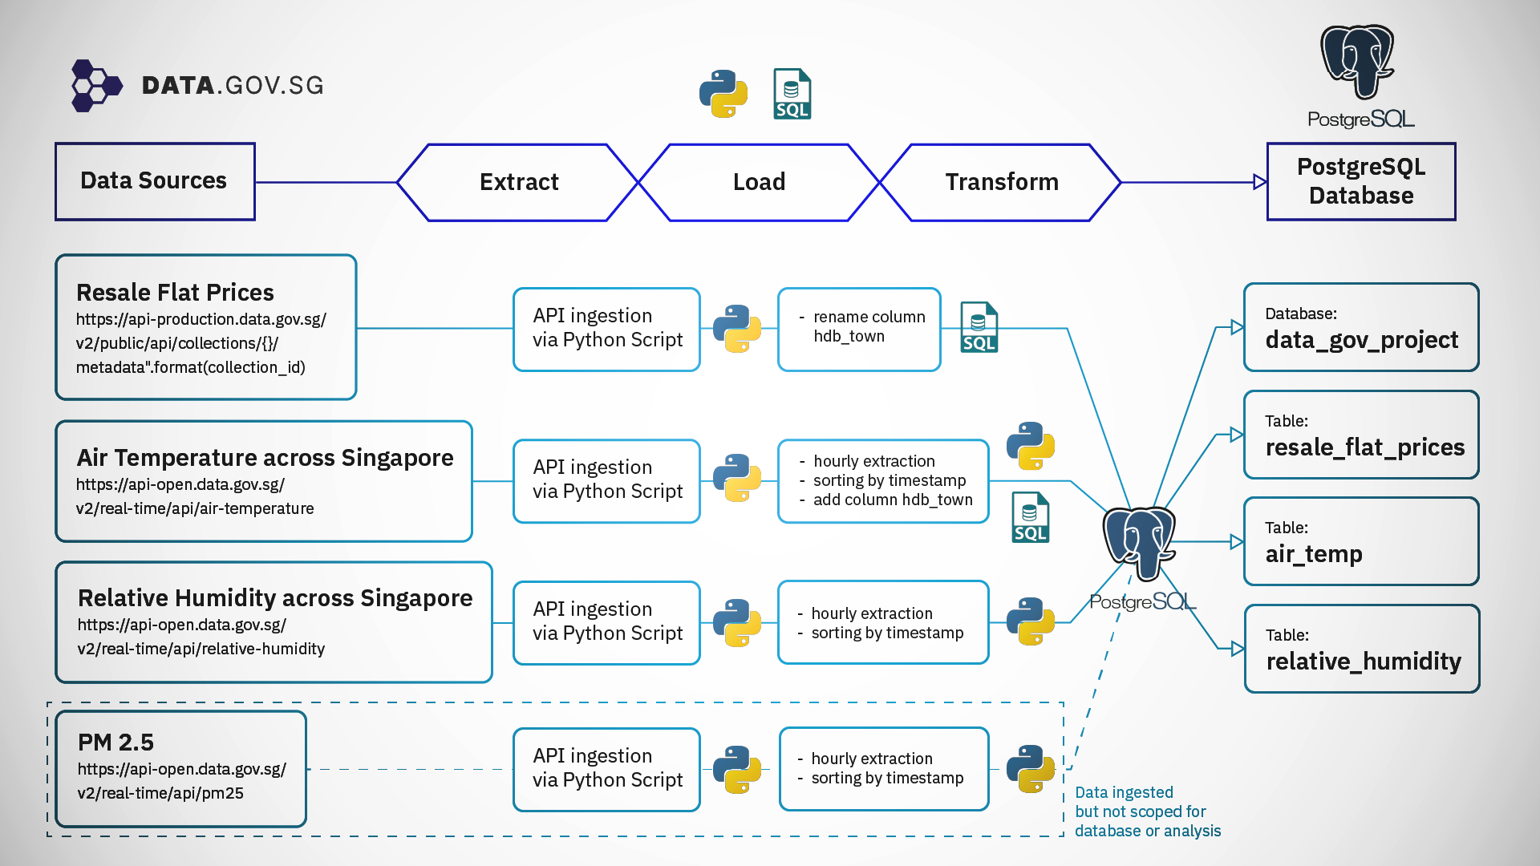

Slide 8


Extract
NEA API https://api.data.gov.sg/v1/environment/air-temperature https://api-open.data.gov.sg/v2/real-time/api/relative-humidity
HDB CSV https://api-production.data.gov.sg/v2/public/api/datasets
Air temperature readings
Humidity readings
HDB transaction prices
DATA.GOV.SG

Slide 9
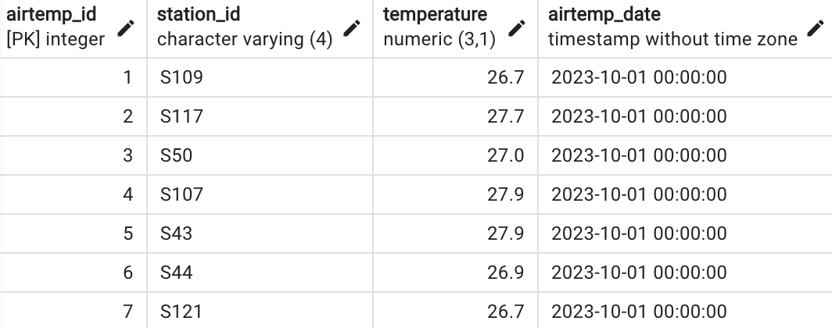
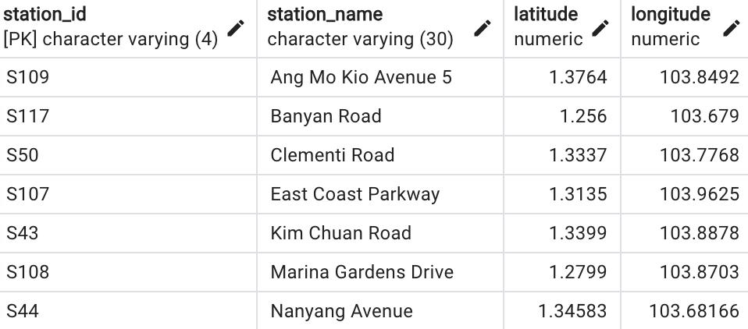
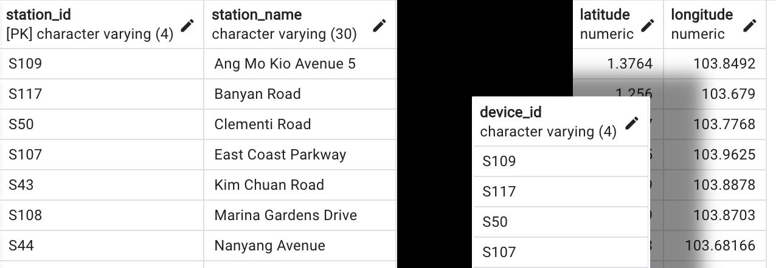
Transform
Data normalisation to reduce redundancy
Split JSON data to different data frames to remove repetition
Drop unnecessary columns
Filter out outliers or incomplete data

Slide 10
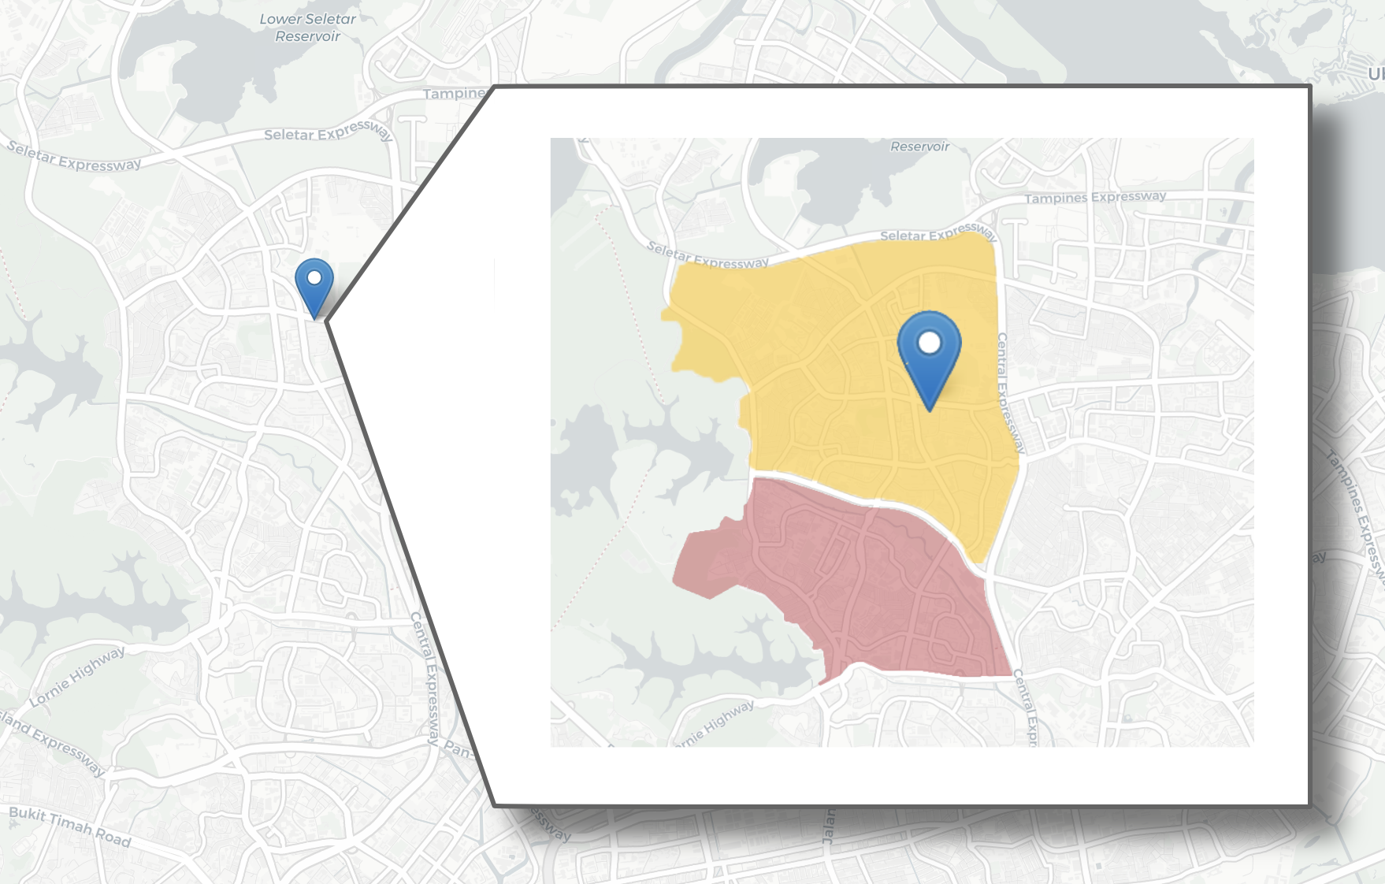

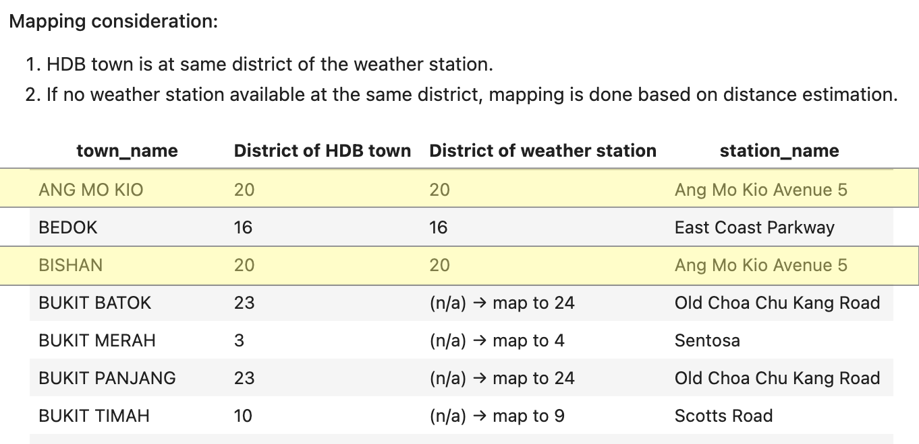
Mapping HDB towns to weather stations
Ang Mo Kio ave 5 station
Ang Mo Kio town
Bishan town

Slide 11

Load
Move data into project database
Database consists of five tables: air temperature, humidity, weather station locations, HDB resale prices
PM2.5 table is available for future analysis

Slide 12
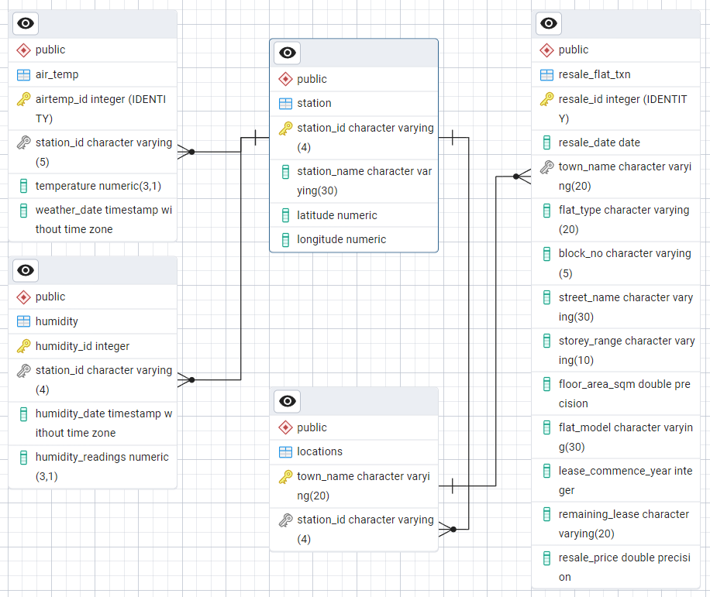
Entity Relationship Diagram
Database Model: Relational Model
Future Consideration: Dimensional Galaxy Model to further reduce dependencies and redunduncies

Slide 13
Analysis PLACEHOLDER
Power BI Charts / bubbles

Slide 14
Analysis PLACEHOLDER
Power BI

Slide 15
Analysis PLACEHOLDER
Power BI

